Slide 1

Week 4 FDR Alignment

Slide 2
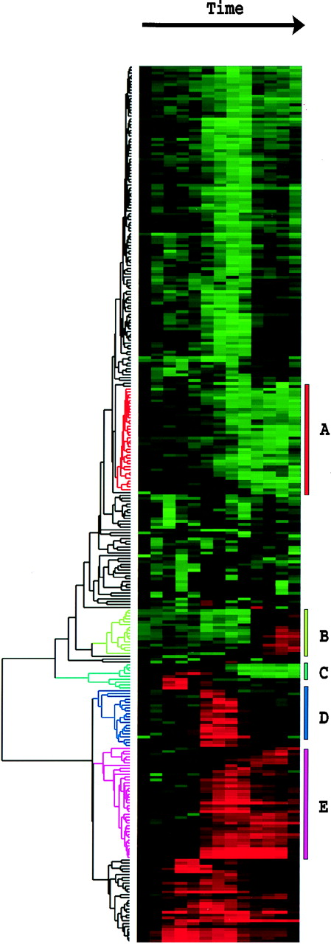
Biology slowly becoming a “big data” science
2010s
Sequenced reads
Millions-billions

Slide 3
Statistical methods are deeply embedded – two concepts
Multiple testing problems
Modeling count data

Slide 4
We can’t use a nominal p-value any longer
P < 0.05
All will be noise!

Slide 5
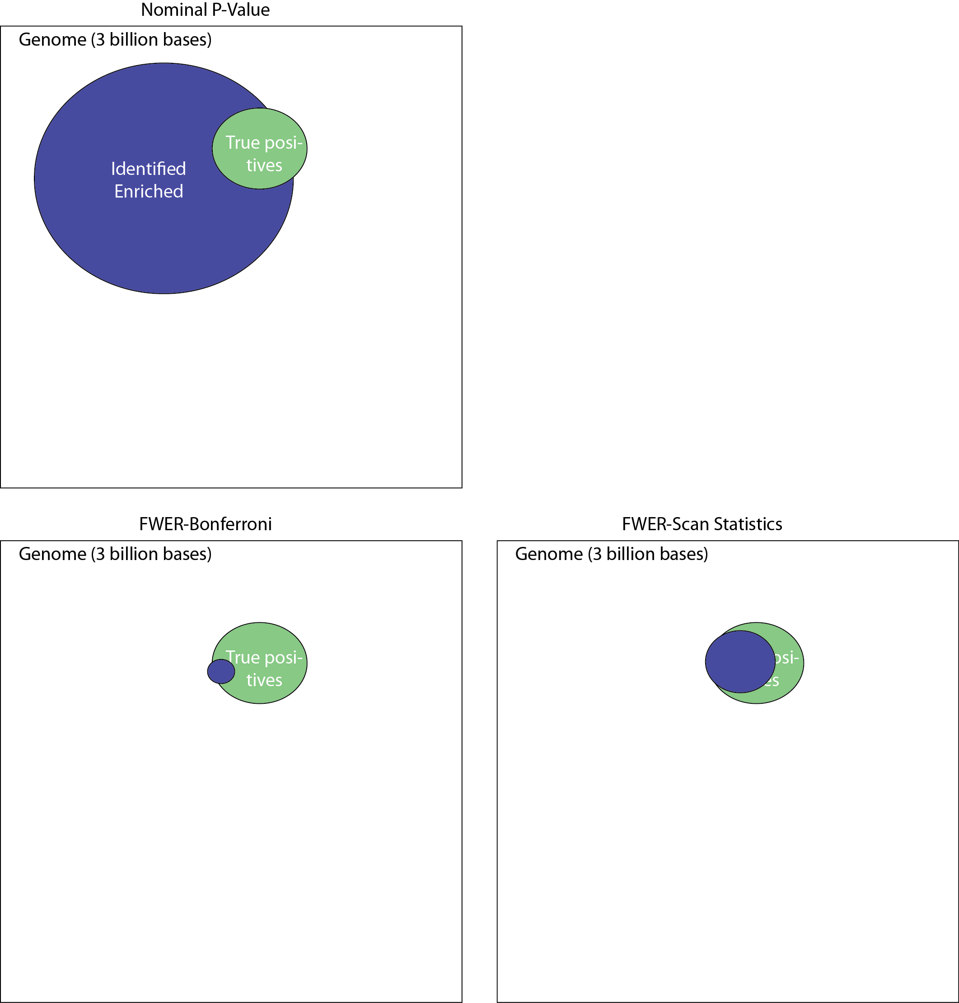
The genome is large, many things happen by chance
Expected ~150,000,000 bases
We need to correct for multiple hypothesis testing

Slide 6
Bonferroni correction is way to conservative
Correction factor 3,000,000,000
Bonferroni corrects the number of hits but misses many true hits because its too conservative – How do we get more power?

Slide 7
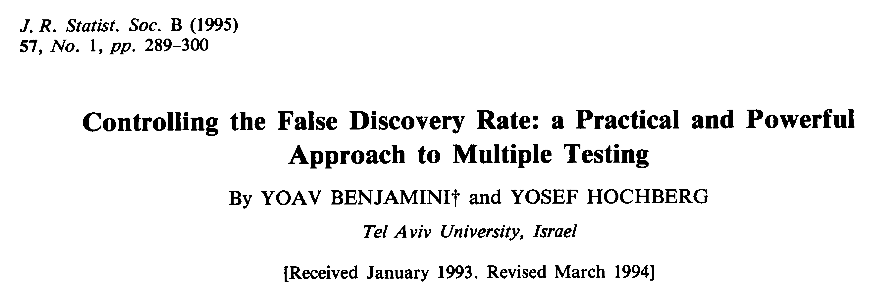
How do we compute significance when we have this much data?
Downloadable from: http://garberlab.umassmed.edu/bootcamp.2015/BH.pdf

Slide 8
A refresher in math notation
The product operator
The summation operator

Slide 9
Expected Value
The expected value of a random variable is the sum of its values weighted by their probability. So, if X is a random variable (e.g. lottery ticket pay-off, Gene expression value) and x_{i} are its discrete values then:
The mean of observed values is an “unbiased” estimator of the expected value of the underlying distribution

Slide 10
Problem formulation
We test m hypothesis (e.g. gene i is differentially expressed m =20,000).
We wish to detect (m-m₀) genes that say change between conditions
 | Do not pass significance | pass significance | Total
Random noise (Null hypothesis is true) | U | V | m₀
True signal (Null hypothesis is false) | T | S | m-m₀
Total | m-R | R | m
V = # Type I errors (False Positives)
T = # Type II errors (False Negatives)
We want to infer E(V | significance), but we only observe R and m
Statistical Power is the ability to reduce Type II errors, a topic for another time!

Slide 11
Definitions
Absent any signal in the data at a nominal p-value α. We have E(V | m,α) = mα.
If we have signal then E(V | m,α) ≤ mα
The probability of making at least one error: P(V>0). Also called Family Wise Error Rate (FWER).
For a given dataset, we would like to compute the fraction of type I errors: (oFDR) = V/R.
FDR := E(V/R)
Notes:
Notice that in order to compute FWER we can compute the p-value for the maximum observed statistics for which we know the null hypothesis is true.
Why was the FWER popular?

Slide 12
Example: Michelob strikes back
Schlitz goes on tour, in every town they conduct a blind test of 50 Michelob faithful
In a few places, Michelob manages to find out who are the blind testers and attempts to train them
Lets assume:
Training improves Michelob detection to 65%
The tour goes to 250 cities

Slide 13
Something is funny
Suspicious shift to the left

Slide 14
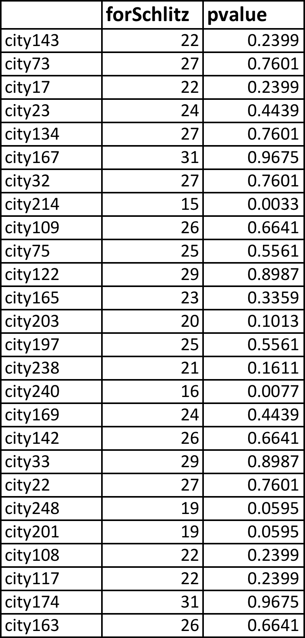
Can Schlitz detect which cities had undergone training?
At 10% we only would talk to less than 10% of cities that did not underwent training. Not too bad

Slide 15
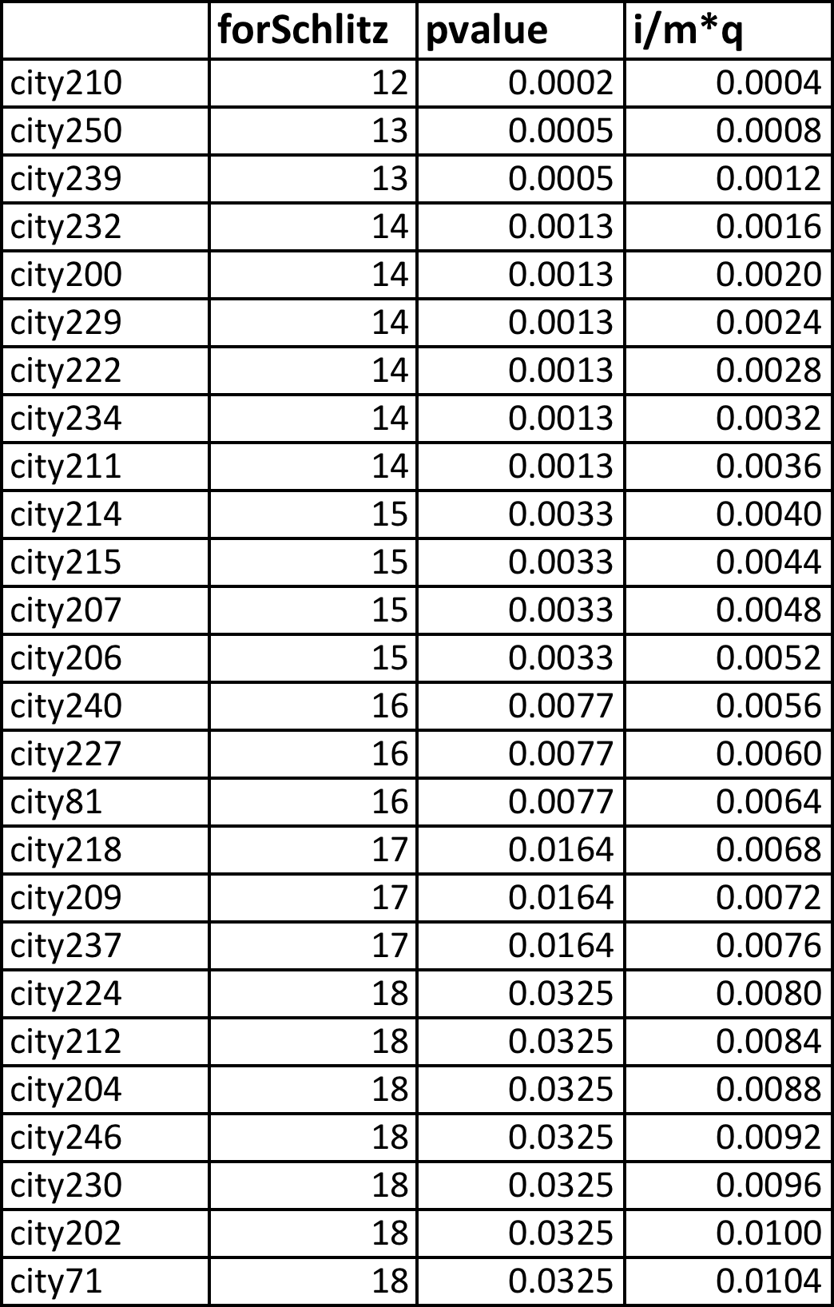
Can Schlitz detect which cities had undergone training?
At 10% we only would talk to less than 10% of cities that did not underwent training. Not too bad
If we were to use Bonferroni, and a 0.1 significant value, we would need a corrected p-value of 0.1/250 = 0.0004. Which would give us ONLY 1 city

Slide 16
Can Schlitz detect which cities had undergone training?
B.H. Procedure:
Find max i, s.t. Pi < i/m*q
At 10% we only would talk to less than 10% of cities that did not underwent training. Not too bad
If we were to use Bonferroni, and a 0.1 significant value, we would need a corrected p-value of 0.1/250 = 0.0004. Which would give us ONLY 1 city
Which gives 13 cities!
Script that generated this data available at class site

Slide 17
Lets get back to sequencing

Slide 18
Our typical RNA quantification pipeline
Upload your
sequence data (fastq)
Make report of quality metrics
Output ribosomal contamination metrics report
Align to the ribosome (Bowtie)
Produce RNA-Seq report
% aligned, % intergenic, % exonic, % UTR
Align remaining reads to genome (TopHat) or transcriptome (RSEM)
Produce IGV/UCSC friendly files
Quantify transcriptome
Produce a table with normalized expression values
Call differentially expressed genes
(if multiple samples)
Report pairwise significant genes that are differentially expressed

Slide 19
Alignment requires pre-processing
Upload your
sequence data (fastq)
Make report of quality metrics
Output ribosomal contamination metrics report
Align to the ribosome (Bowtie)
Align remaining reads to genome (TopHat) or transcriptome (RSEM)
bowtie2-build -f mm10.fa mm10
rsem-prepare-reference \
--gtf ucsc.gtf --transcript-to-gene-map ucsc_into_genesymbol.rsem \
mm10.fa mm10.rsem

Slide 20
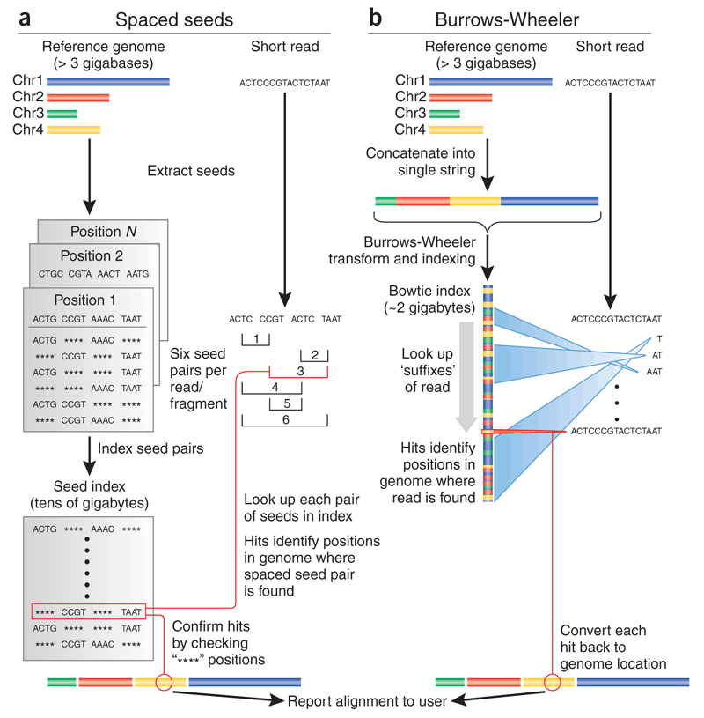
Trapnell, Salzberg, Nature Biotechnology 2009

Slide 21
Spaced seed alignment – Hashing the genome
G: accgattgactgaatggccttaaggggtcctagttgcgagacacatgctgaccgtgggattgaatg……
Store spaced seed positions
accg attg **** ****
0
0
0,45
0
0
0
accg **** actg ****
accg **** **** aatg
**** attg actg ****
**** attg **** aatg
**** **** actg aatg
ccga ttga **** ****
1
1
1
1
1
1
ccga **** ctga ****
ccga **** **** atgg
**** ttga ctga ****
**** ttga **** atgg
**** **** ctga atgg
Notes:
Of course there are on average tens of thousands of entries in each table cell.

Slide 22
Spaced seed alignment – Mapping reads
G: accgattgactgaatggccttaaggggtcctagttgcgagacacatgctgaccgtgggattgaatg……
accg attg **** ****
0
0
0,45
0
0
0
✕
q: accg atag accg aatg
accg **** actg ****
✕
accg **** **** aatg
✓
accgattgactgaatg
accgtgggattgaatg
**** attg actg ****
✕
**** attg **** aatg
✕
2 missmatches
5 missmatches
**** **** actg aatg
✕
ccga ttga **** ****
1
1
1
1
1
1
✕
Report position 0
ccga **** ctga ****
✕
ccga **** **** atgg
✕
But, how confident are we in the placement?
**** ttga ctga ****
✕
**** ttga **** atgg
✕
**** **** ctga atgg
✕
Notes:
What is the advantage of spaced k-mers?

Slide 23
Mapping quality
What does
mean?
Lets compute the probability the read originated at genome position i
q: accg atag accg aatg
q_{s} : 30 40 25 30 30 20 10 20 40 30 20 30 40 40 30 25
, the PHRED score. Equivalently:
So the probability that a read originates from a given genome position i is:
In our example

Slide 24
Mapping quality
What we want to estimate is
That is, the posterior probability, the probability that the region starting at i was sequenced given that we observed the read q:
Fortunately, there are efficient ways to approximate this probability (see Li, H genome Research 2008, for example)
Notes:
We really do not care about the probability that such read is generated by the region starting at position i, instead we want to know what is the probability that we sequenced the region at position i, given that we see the read q.

Slide 25
RNA-Seq Read mapping
Notes:
If you have a reference genome of high quality, mapping reads leverages this information. Most eukaryote transcripts result from splicing events. RNASeq reads come from molecules that map to the genome as small exons within several KBs of genomic sequence. This makes RNA-Seq reads particularly complex to map. RNASeq reads come in three flavors: Those that map to single exons, those that map to two or more spliced exons and those that contain portions of the PolyA tail. Mapping all three classes results in optimal, coverage, connectivity and transcript end mapping.

Slide 26
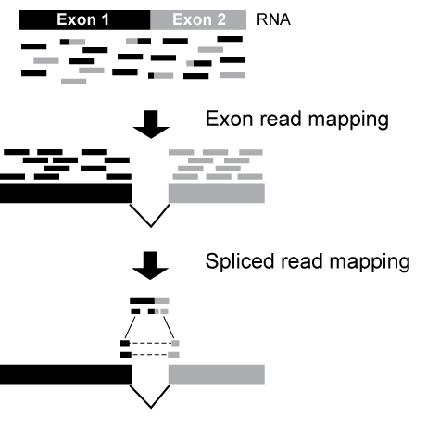
Mapping RNA-Seq reads: Exon-first spliced alignment (e.g. TopHat)

Slide 27
Short read alignment
Upload your
sequence data (fastq)
Make report of quality metrics
Output ribosomal contamination metrics report
Align to the ribosome (Bowtie)
Align remaining reads to genome (TopHat) or transcriptome (RSEM)
tophat2 --library-type fr-firststrand --segment-length 20 \
-G genome.quantification/ucsc.gtf -o tophat/th.quant.ctrl1 \
genome.quantification/mm10 fastq.quantification/control_rep1.1.fq \
fastq.quantification/control_rep1.2.fq
/project/umw_biocore/bin/igvtools.sh count -w 5 tophat/th.quant.ctrl1.bam \ tophat/th.quant.ctrl1.bam.tdf genome.quantification/mm10.fa

Slide 28
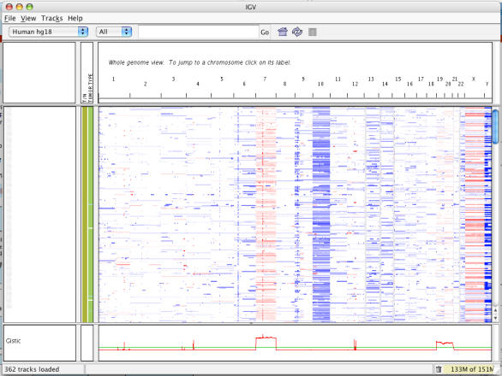
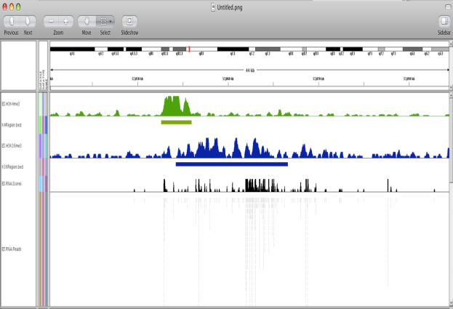
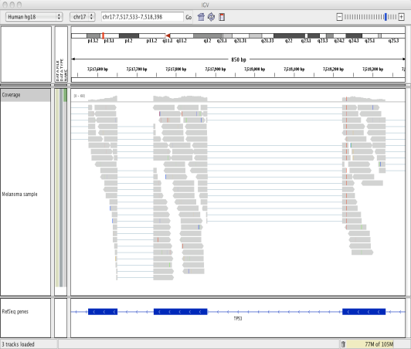
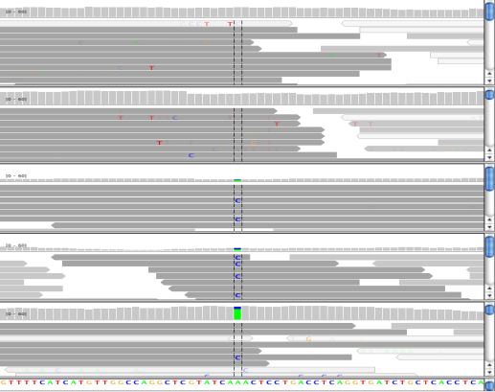
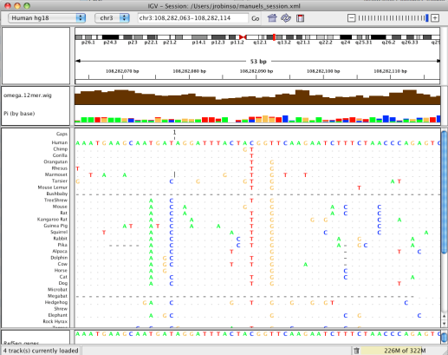
IGV: Integrative Genomics Viewer
A desktop application
for the visualization and interactive exploration
of genomic data
Microarrays
Epigenomics
RNA-Seq
NGS alignments
Comparative genomics
Notes:
Visualization of data is a key need in this field, IGV currently has all the necessary features to allow
* Desktop app – you run on your computer – not through a Web browser (like UCS genome browser)
Viewer – not computational tool
Supports any type of data that can be mapped to the genome.
Ask who works with what type of data

Slide 29
Visualizing read alignments with IGV — RNASeq
Strand specific library!
Gap between reads spanning exons

Slide 30
Visualizing read alignments with IGV — zooming out

